Slide 1

MuSa
The experience manager
designed by Silvia Del Piano, Stefano Foti and Gianmarco Zizzo

Slide 2

TECHNICAL UPDATE

Slide 3

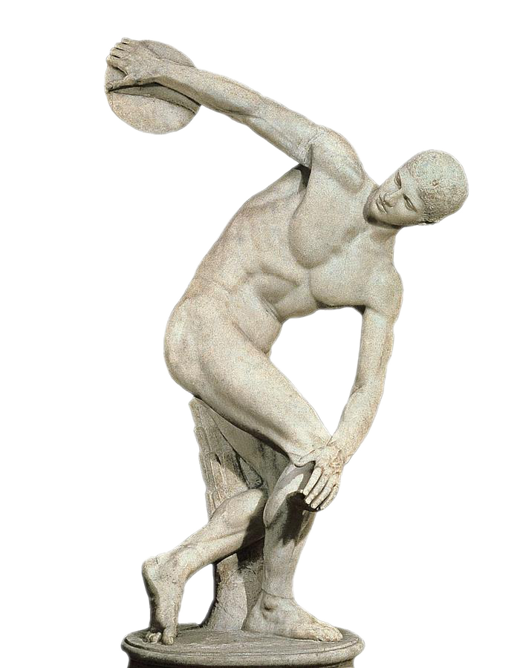



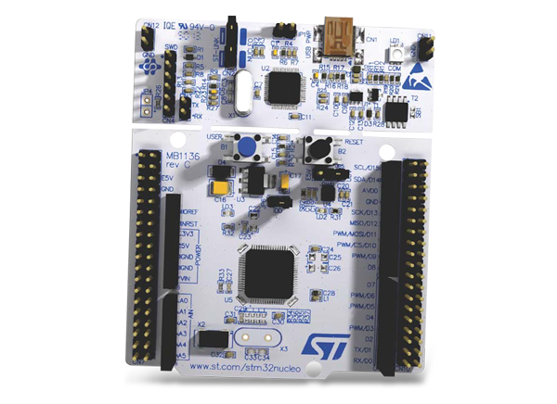




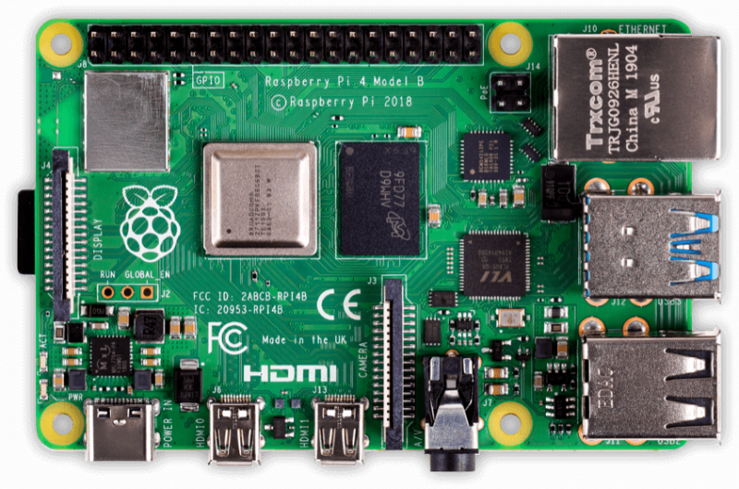
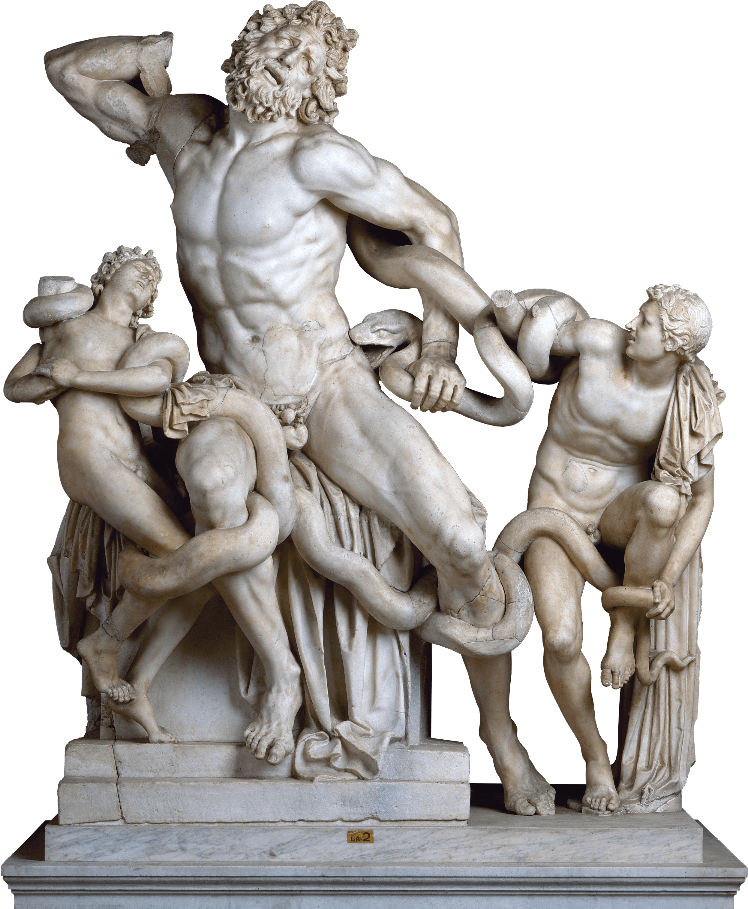

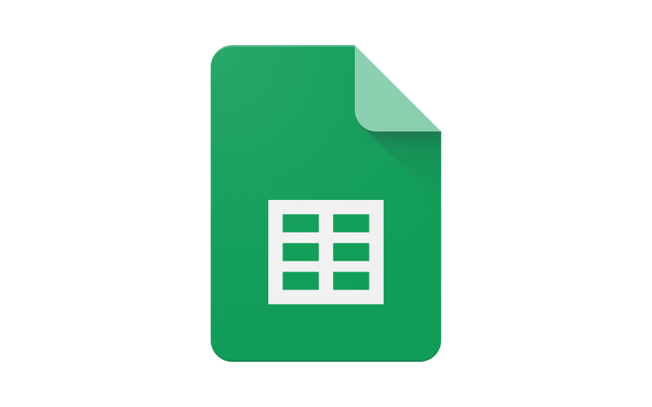
Azure IoT Hub
App Service
MQTT-SN
Azure DB
MQTT
MQTT-SN
Azure ML
Sheets

Slide 4






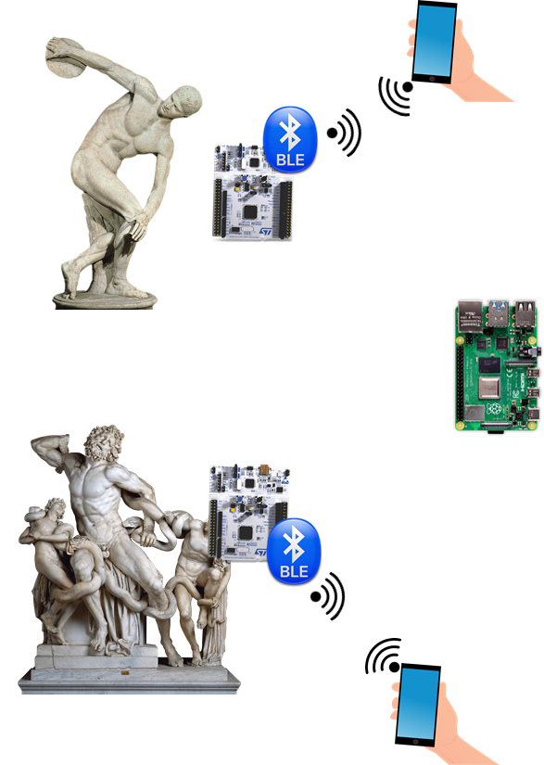
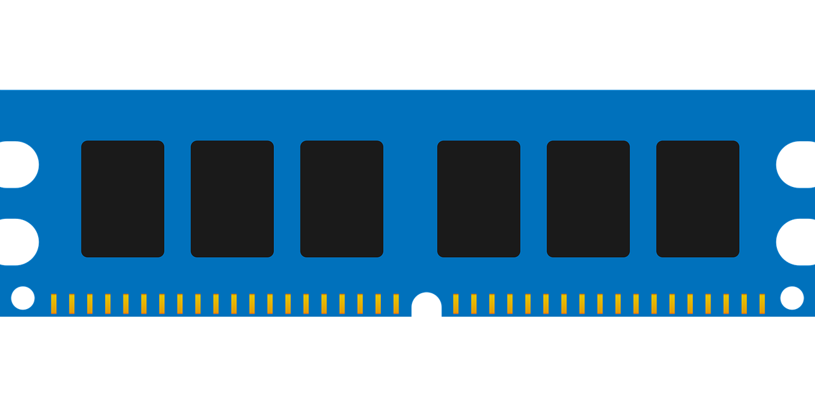
Azure IoT Hub
Event Hub
App Service
MQTT
Azure DB
EF6
BE
FE
Sheets
Azure ML

Slide 5
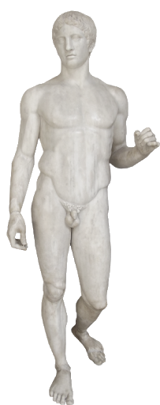
POSITIONING ARCHITECTURE
Server based positioning
The visitor has a tag that advertises their MAC address or UUID. The signal is catched by specific hardware and which is then transmitted to server for calculating and gathering statistics.

Slide 6
EVALUATION
A presentation about the evaluation done so far

Slide 7
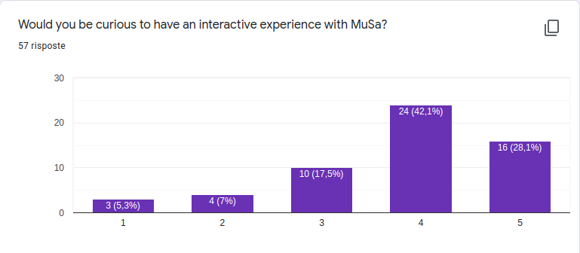
USER’S FEEDBACK During the development process we're keeping track of the opinions of the users to understand if we're effectively building something of value. In particular, the following results of the surveys we made are quite encouraging.
We can see that the majority of the users would at least be curious to try MuSa.

Slide 8
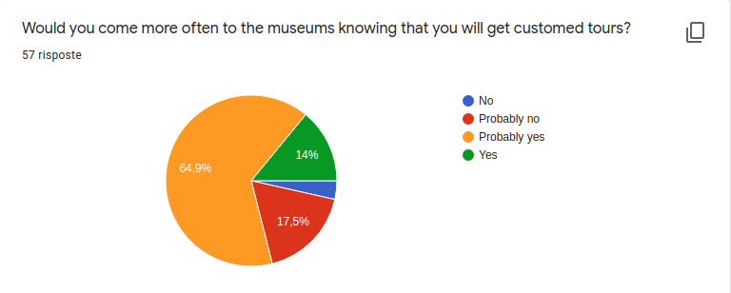
USER’S FEEDBACK During the development process we're keeping track of the opinions of the users to understand if we're effectively building something of value. In particular, the following results of the surveys we made are quite encouraging.
Our application could be useful for the museum to attract more visitors, thanks to making their experiences there more enjoyable.

Slide 9
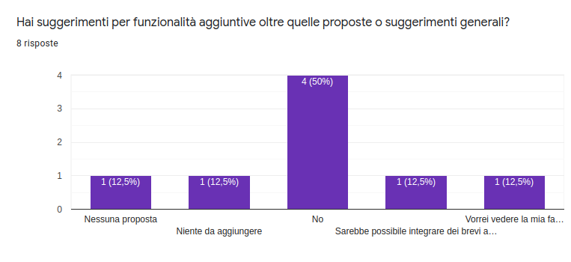
USER’S FEEDBACK During the development process we're keeping track of the opinions of the users to understand if we're effectively building something of value. In particular, the following results of the surveys we made are quite encouraging.
We can be reassured on the fact that we're catching the main needs of the users, since, a part from some peculiar suggestions, the majority of them doesn't feel the need to point out more functionalities to add with respect to the ones already presented.

Slide 10
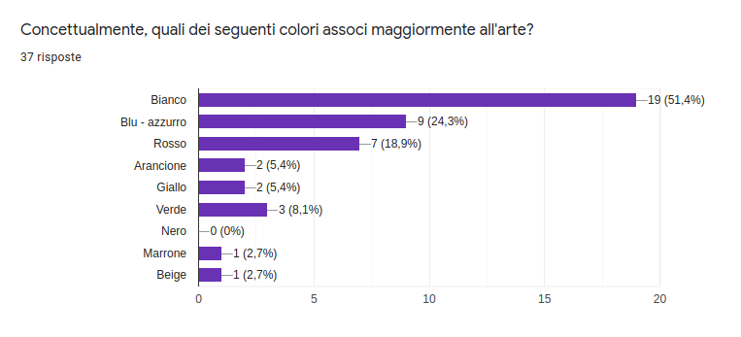
USER’S FEEDBACK During the development process we're keeping track of the opinions of the users to understand if we're effectively building something of value. In particular, the following results of the surveys we made are quite encouraging.
We're also taking into account our user's opinion to build an interface which can be to their liking.

Slide 11
COMPLEXITY & RESPONSIVENESS
We need our system to be responsive to follow the user in real-time during his visit, but at the same time we also don't want to flood our network with messages, keeping the complexity low, also to save the board's power.
This also affects the cost: we want to push the limits of our free plan to exploit it to the fullest (the limit of messages we can send to Azure is 8000 per day), so that we can pay as less as possible.
This can be achieved by taking advantage of edge computing: we do data pre-processing in the gateway to aggregate messages of different boards and send to Azure a single report.

Slide 12
COMPLEXITY & RESPONSIVENESS
Let's do a short evaluation in terms of complexity and responsiveness of this system, let's consider the following scenario:
- we have 30 STM-Nucleo boards that send 1 message per second
- raw data is sent to Azure: this means that there are around 30 messages * 60 s = 1800 messages each minute, which means that in 8000 / 1800 = 4,4 minutes the free plan would expire.
- edge computing: instead of sending the messages directly to Azure, they are collected by the gateway, which instead sends to the cloud a report every 5 seconds. So we have 60 / 5 = 12 messages per minute, which means that the free plan would last for 8000 / 12 = 666,66 minutes, which is 11,11 hours.
So we have 5 minutes vs 11 hours a day, the advantages of the edge computing architecture are immense! We could have a museum with 30 boards use our system for free each day (unless it stays open for more than 11 hours).

Slide 13
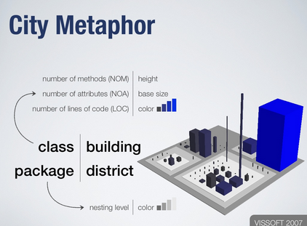
CODE CITY AND THE BACKEND
CodeCity Tool
Our backend code quality will be tested with CodeCity. It is a very simple tool that allows to check the most common software metrics in a new way in which software systems are visualized as interactive, navigable 3D cities. The classes are represented as buildings in the city, while the packages are depicted as the districts in which the buildings reside. The more the city is well structured, the higher the code quality is.
CodeCity better performs with huge projects

Slide 14
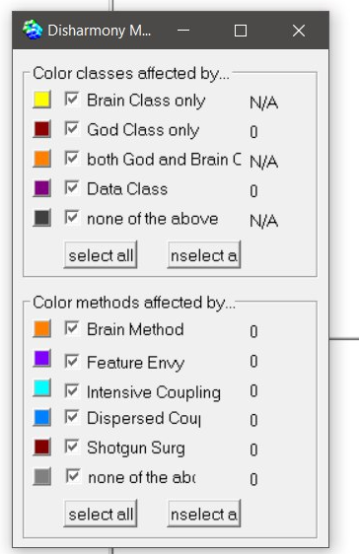
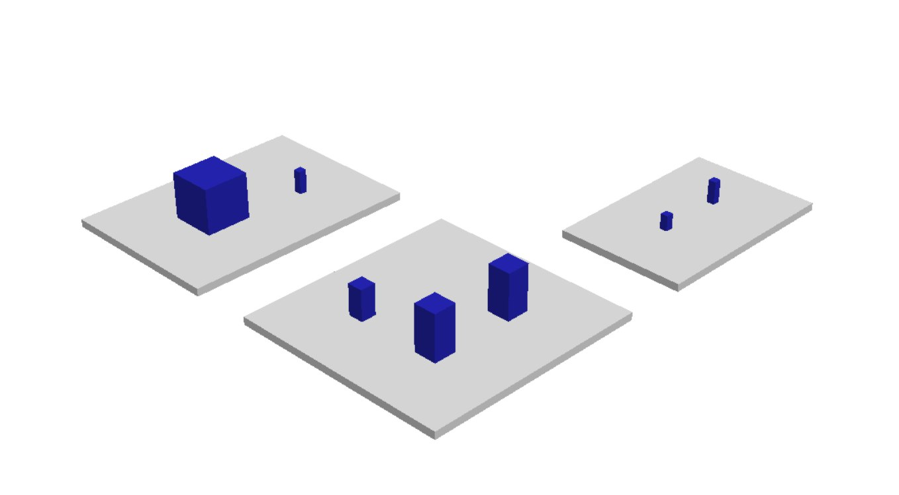
CODE CITY AND THE BACKEND
MuSa City
Specific metrics

Slide 15
SENSOR NETWORK RELIABILITY
Having a board that acts as a gateway is a single point of failure!
Redundancy approach: we have a second Raspberry Pi in hot standby.
Every time the gateway sends the report to Azure via MQTT, also the second Raspberry receives it. If the second board doesn't receive any message for a certain amount of time, it will assume that the main gateway has suffered a failure, and therefore replaces the faulty board taking its place as the gateway.

Slide 16
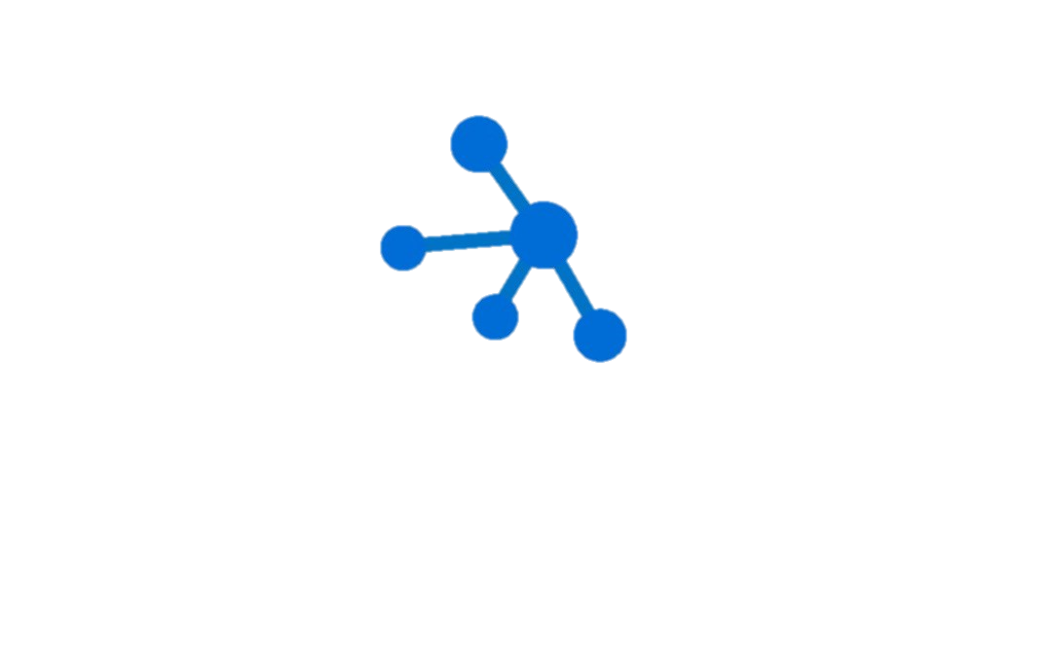
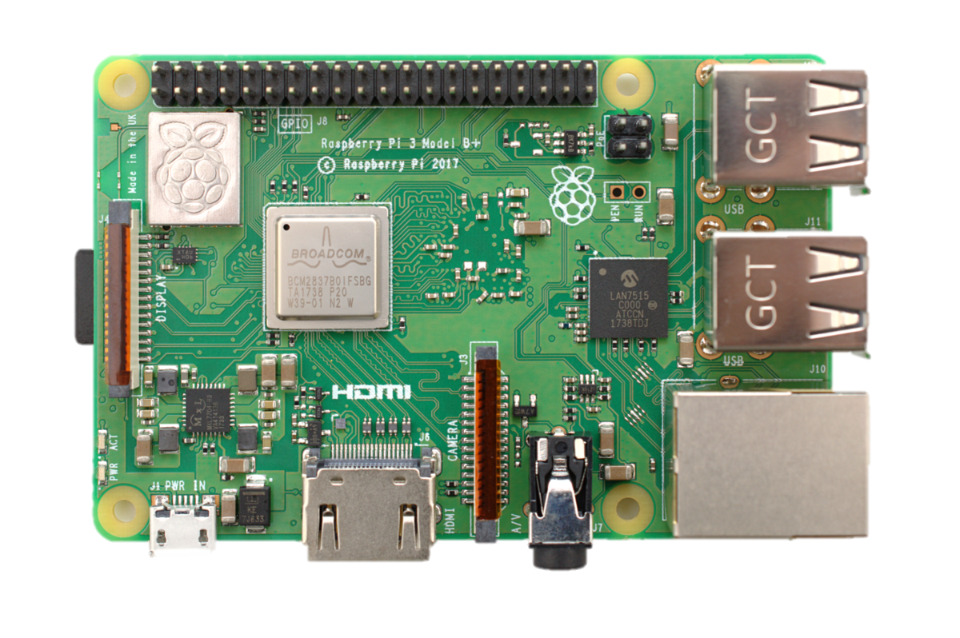
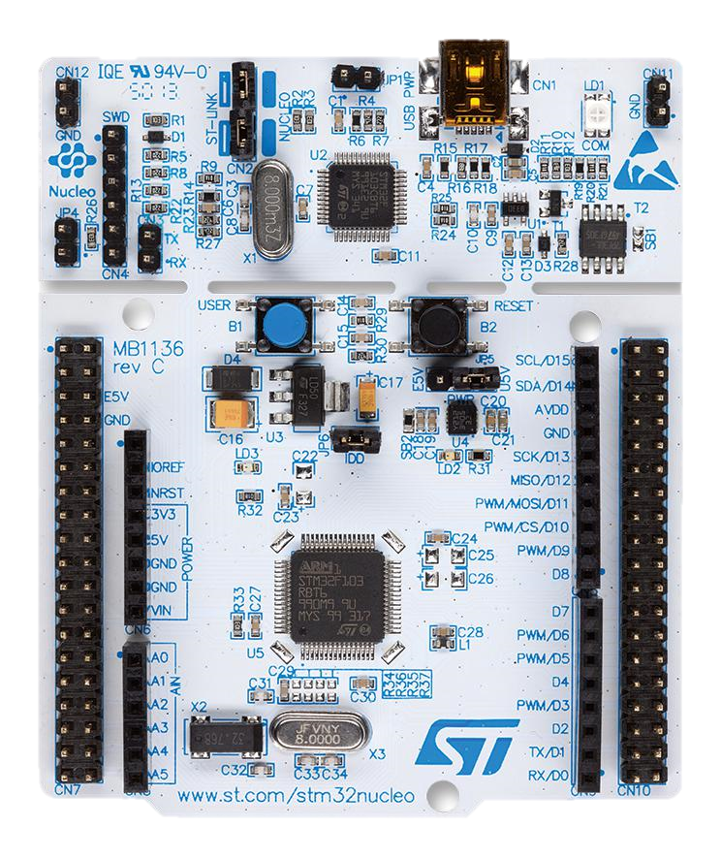
Azure IoT Hub
Azure Database
Azure App Service Plan
PRICE
STM-Nucleo
UPDATED COST EVALUATION
Azure Machine Learning
Free until
8000 messages/day
Free for
the previous Azure Database generation (the 4th),
few GB of space
Major drawback:
you can not have any backup possibility
Free
complete solution to deploy a full-stack application with both FE and BE.
1GB of storage
1GB of RAM
shared CPU
Please note that in such a way you can not keep your application always running.
Does not offer any free plan It starts at about
4 USD/month.
Raspberry Pi
> 20 €
10 – 15 €
+
20 – 30 € for Wi-Fi and BLE expansions
For further details, please have a look at Microsoft Pricing Calculator.

Slide 17
FUTURE PLANS
for technical development and evaluation until the final delivery

Slide 18
TECHNICAL DEVELOPMENT
Deploy on Azure
Since that part of the demo is simulated or runs in local.
A great part of MuSa lives in the Cloud and we will need Azure IoT Hub, Azure ML, Azure DB and Azure App Service
Providing the
personalized tours
to the visitors
One of MuSa’s main features is to provide personalized tours and we want to realize
a profiling questionnaire that makes MuSa able to serve something that matches perfectly with visitor’s interests, also using the information that we got with our online survey

Slide 19
TECHNICAL DEVELOPMENT
Data collection
For both visitors types: the one who uses MuSa and the one that only wants to help the improving with the data collecting
The interaction
The "interaction" with the artwork, understood as when a visitor is near an artwork, through his smartphone he can ask for some extra information or curiosities

Slide 20
FUTURE EVALUATION
The user experience
We care a lot about our visitors: our main goal is to make them happy!
We will evaluate the user experience with a Moment method and an Episode method:
we expect to do this through the tools PrEmo and AttrakDiff
Overall system
It is very important to provide a system qualitatively good and we will analyze it through the guidelines by ISO/IEC 9126-1. We used a criteria-based evaluation which gives a measurement of quality in several areas, including understandability, documentation and portability

Slide 21
FUTURE EVALUATION
Power consumption, communication complexity
and scalability…
… of the sensor network because we want to build a maintainable and consistent system
Price considerations
We will do a revision about the expected price of the whole system because we want to make MuSa easily accessible and doable. This will include the price of the hardware and the price of the Azure plan needed, computable with Microsoft Pricing Calculator.

Slide 22
THANKS FOR YOUR ATTENTION

